Slide 1

SF Data Analysis -
How Does Crime Impact Real Estate Prices
1.
Team Name: Group 5
Team Members: Nate Marohl, Andrew Seaman, Michael Nutile
1.https://journalistsresource.org/studies/economics/real-estate/the-impact-of-crime-on-property-values-research-roundup/?fbclid=IwAR2Oxqo5An7hHZMzp9ZvfjOzRb3LpLOxTMmt83Jz9osUyPGxTc5ZCTcQgJA

Slide 2

Agenda
Problem overview
Datasets
Cleaning the data
Merging data
Transforming into charts
2.
Problem Statement
Data Overview
Cleaning & Transformation
Merging & Grouping
Conclusions
Findings
2. https://www.clipartmax.com/download/m2i8K9i8Z5G6Z5N4_meeting-room-clip-art-meeting-room-clip-art/
Notes:
Mike

Slide 3
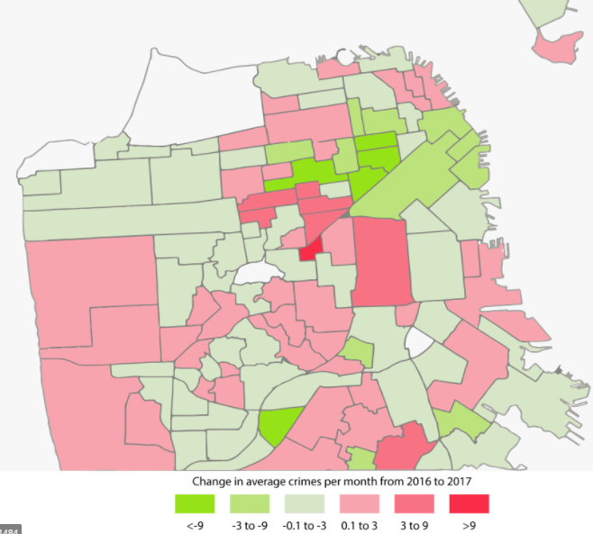
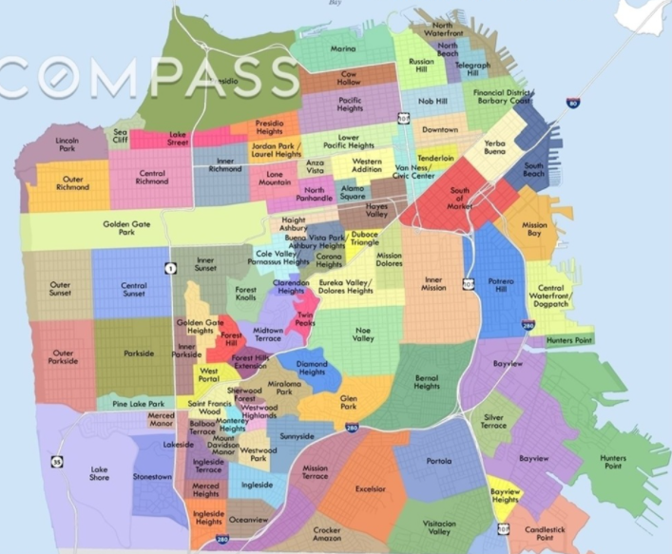
Problem Statement
Problem overview
Datasets
Cleaning the data
Merging data
Transforming into charts
Our data analysis firm represents a major real estate developer who is interested in purchasing a property in SF. In order to make an informed decision for our client, we want to explore the relationship between prices and rates of crime to determine how their purchase can be impacted.
3.
4.
3. https://abc7news.com/san-francisco-violent-crime-uptick-analysis-crimes-in-hoodline-abc7-news/1817758/*
4. https://www.bayareamarketreports.com/trend/san-francisco-neighborhood-map
Notes:
Mike

Slide 4

Dataset 1: SF Police Incident Report
5.
Problem overview
Datasets
Cleaning the data
Merging data
Transforming into charts
5.
Purpose: A collection of police reports filed by both officers and members of the public
Data starts from January 2018
Incidents are approved by a supervising Sergeant or Lieutenant
Includes only incidents from inside SF
Details include neighborhood, crime type, and location (lat/long)
~406,044 incidence records as of Nov 22nd 2020
5. https://data.sfgov.org/Public-Safety/Police-Department-Incident-Reports-2018-to-Present/wg3w-h783/data
Notes:
Andrew

Slide 5
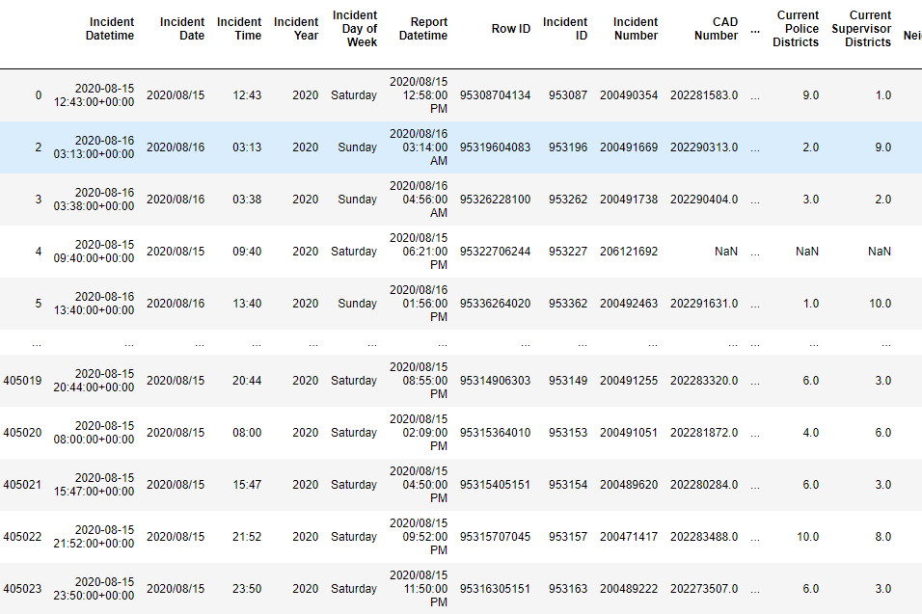
Notes:
Andrew

Slide 6


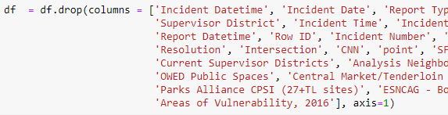
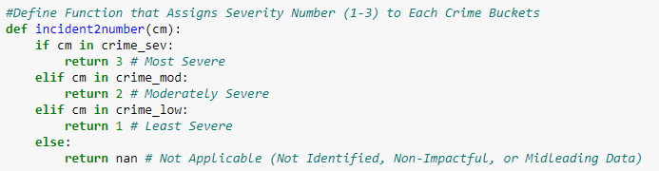

Transforming Dataset 1:
5.
Problem overview
Datasets
Cleaning the data
Merging data
Transforming into charts
Unnecessary historical data
Too many columns
Does not identify incident month
Does not assign crime severity
Has NaN data (lat/long/IncNum)
5. https://data.sfgov.org/Public-Safety/Police-Department-Incident-Reports-2018-to-Present/wg3w-h783/data
Notes:
Andrew
Eliminated 2018,2019
Removed columns and identified incident month
Assigned Severity
3 - Most Severe
2 -Moderately Severe
1 -Least Severe

Slide 7
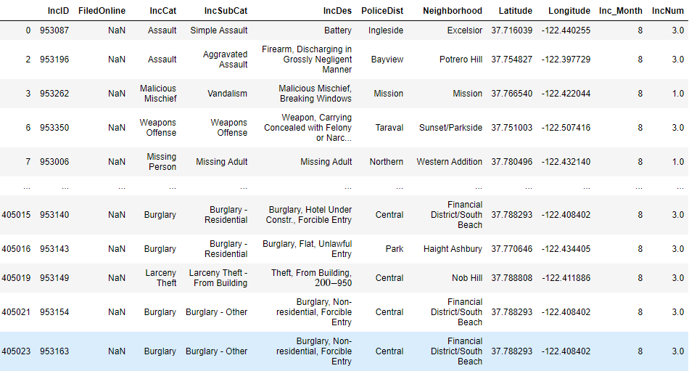
Notes:
Andrew
IncNum =

Slide 8
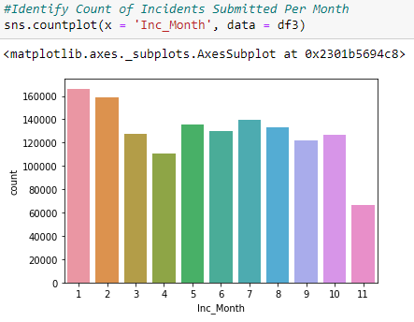
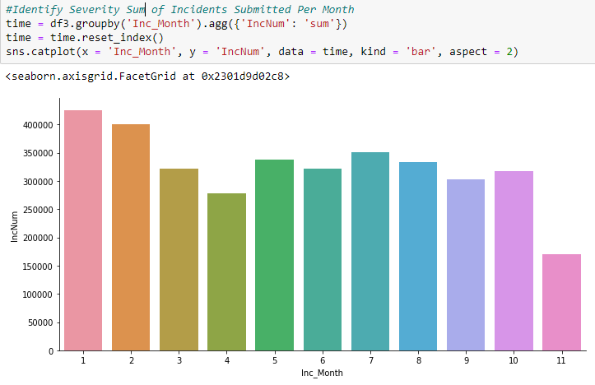
!Fun Fact!
Problem overview
Datasets
Cleaning the data
Merging data
Transforming into charts
COVID led to a significant lowering of SF incident count
By Incident Count
By Severity Sum
Notes:
Mike
High Sev: 'Arson', 'Assault', 'Burglary', 'Larceny Theft', 'Motor Vehicle Theft', 'Robbery', 'Sex Offense', 'Weapons Carrying Etc', 'Weapons Offense', 'Rape', 'Human Trafficking (A), Commercial Sex Acts', 'Homicide', 'Weapons Offence', 'Human Trafficking, Commercial Sex Acts', 'Human Trafficking (B), Involuntary Servitude'
Vs:
Low Sev: 'Disorderly Conduct', 'Drug Offense', 'Malicious Mischief', 'Missing Person', 'Stolen Property', 'Vandalism', 'Drug Violation', 'Gambling']
Crime_remove: 'Case Closure', 'Courtesy Report', 'Embesslement','Fire Report','Forgery And Counterfeiting','Fraud','Lost Property','Miscellaneous Investigation','Non-Criminal','Other','Other Miscellaneous','Other Offenses','Recovered Vehicle','Suicide','Suspicious Occ','Traffic Collision','Traffic Violation Arrest','Vehicle Misplaced','Warrant','Vehicle Impounded','Motor Vehicle Theft','Suspicious','Civil Sidewalks','Liquor Laws'

Slide 9

Dataset 2: Redfin Real Estate Prices
6.
7.
Problem overview
Datasets
Cleaning the data
Merging data
Transforming into charts
Purpose: A collection of information on houses listed by Redfin in the SF area as of November 11th, 2020
Details include zip code, neighborhood, price per sq ft, and location (lat/long)
350 entries in the dataset
6. https://www.redfin.com/city/17151/CA/San-Francisco
7. https://www.redfin.com/
Notes:
Nate

Slide 10
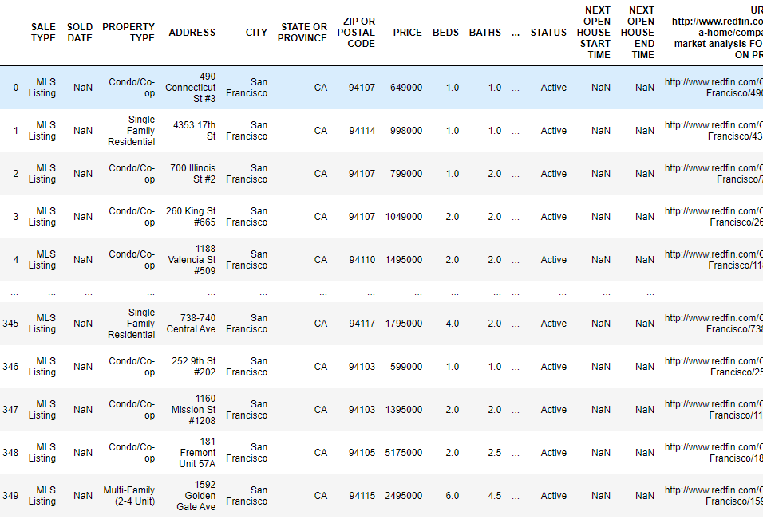

Slide 11

Transforming Dataset 2:
Problem overview
Datasets
Cleaning the data
Merging data
Transforming into charts
Too many columns
Group into summary data by Location
Notes:
Nate

Slide 12
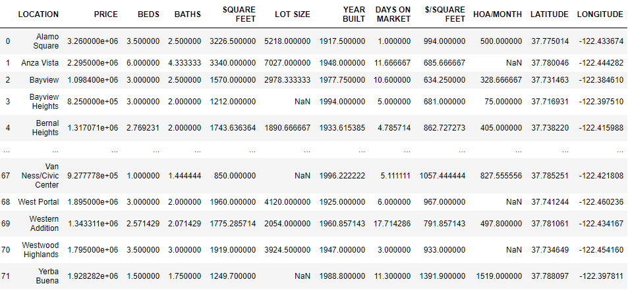

Slide 13
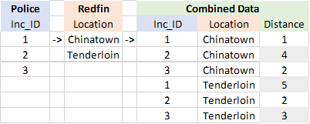

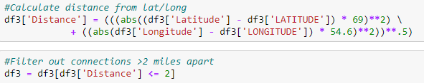
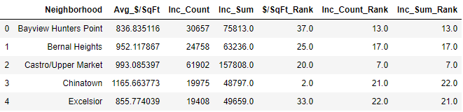
Dataset 3: Connection Data
Problem overview
Datasets
Cleaning the data
Merging data
Transforming into charts
Purpose: Identifies incidents in neighborhoods
Many to many relationship
Compiled via merge function
Filtered on distance in miles (<2 miles)
Calculated via lat/long
Group end result by neighborhood & rank
Notes:
Nate

Slide 14
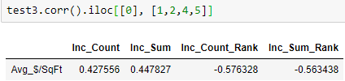
Conclusions Pt. 1:
Problem overview
Datasets
Cleaning the data
Merging data
Transforming into charts
Count & severity of incidents to price have a weak correlation
Location rank is more correlated to price than incident count & severity
Notes:
Mike:
-At first we tested for individual crime incidents, with a two mile spread (we tested one mile and three miles and two miles actually had the highest correlation)
-Individual correlation wasn’t as strong as the hypothesis set out to test.
-Improved correlation by using rank.
-Further improved correlation by putting rank into 5 bins; raising the correlation to about .6
-This makes sense… crime is a single factor, and SF has issues with Inequality, job demand, population density, building security.

Slide 15
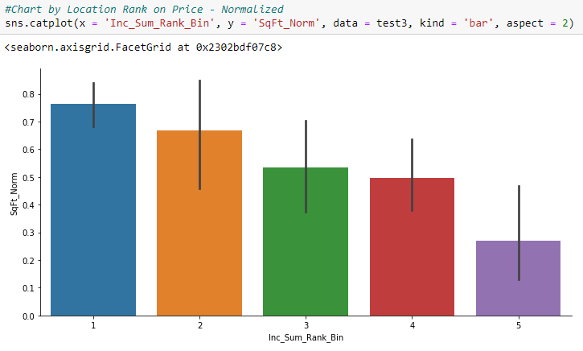

Conclusions Pt. 2:
Problem overview
Datasets
Cleaning the data
Merging data
Transforming into charts
Location rank in bins (<5) is more correlated to price than straight rank

Slide 16
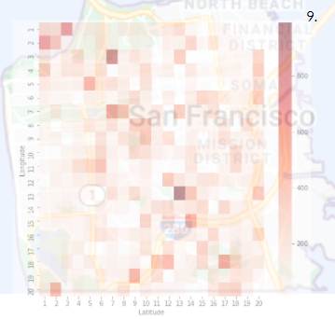
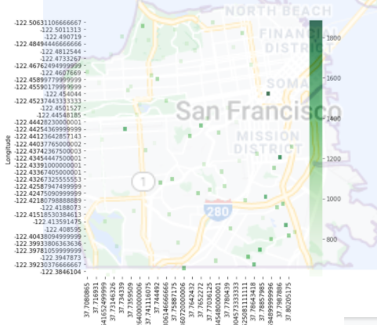
Findings
9.
10.
Problem overview
Datasets
Cleaning the data
Merging data
Transforming into charts
Incident count & impact are only weakly correlated to real estate price
Why?
Demand for housing close to jobs is higher
Greater populated areas have more crime
Security between houses and apartments vary greatly
Distance from crimes vary
Income inequality in the Bay Area
8.
8. https://www.kqed.org/news/11799308/bay-area-has-highest-income-inequality-in-california
9. & 10. Project Data Heatmap layover of Map found here https://www.google.com/search?q=sf+map&oq=sf+map&aqs
Notes:
Nate

Slide 17
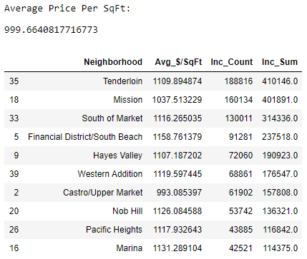
Note: Out of the top 10 locations with the highest crime, only 1 has a price less than the average for SF!
Problem overview
Datasets
Cleaning the data
Merging data
Transforming into charts
Notes:
Nate

Slide 18
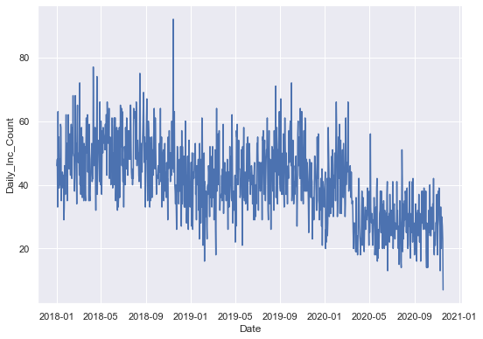
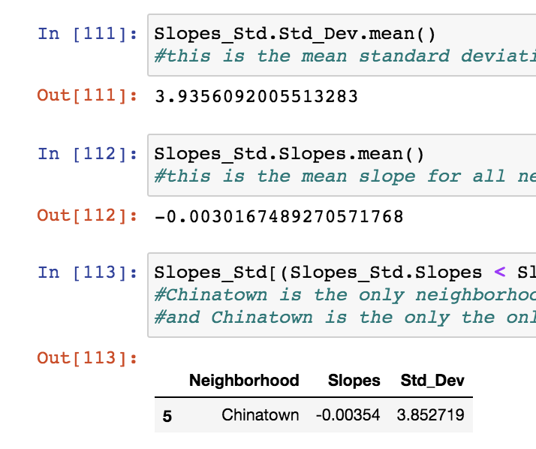
Trend Analysis
We took the police data and performed time series analysis
For each Neighborhood we got a slope and standard deviation
Decreasing slope = crime going down
Increasing slope = crime going up
Mission Neighborhood
We found that China Town is the only neighborhood with a slope < average slope AND std < average std
Notes:
Recommendation: Invest in ChinaTown if you are looking for a neighborhood where crime is trending down.

Slide 19
Appendix

Slide 20
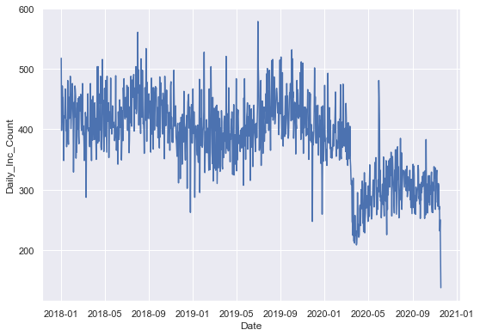
Trend Analysis - All Neighborhoods

Slide 21
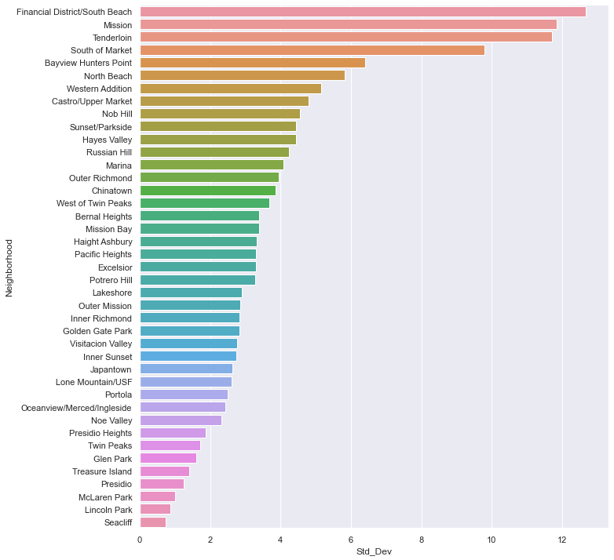
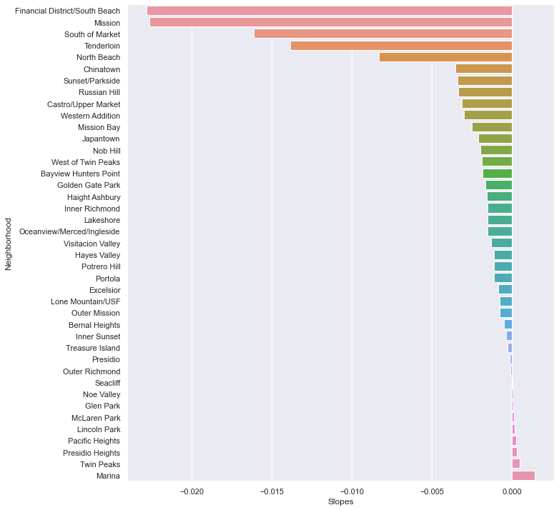
Standard Deviation and Slope Trend

Slide 22
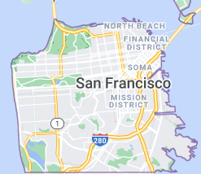
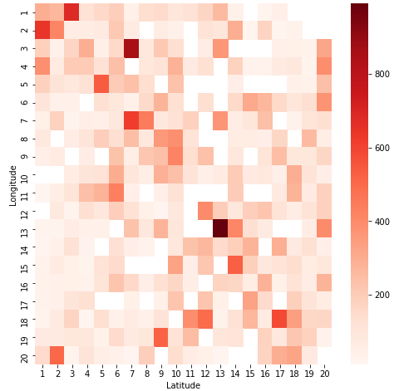
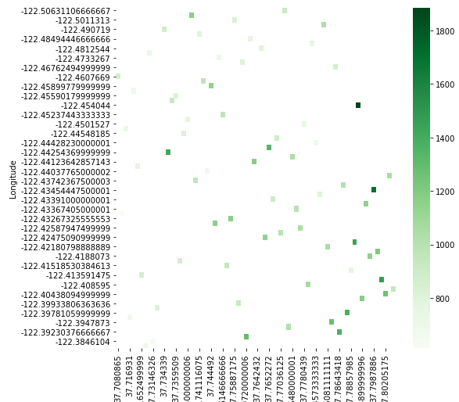
Crime and Real Estate Closeup Snapshot
Problem overview
Datasets
Cleaning the data
Merging data
Transforming into charts
9.
10.
8.
9. & 10. Project Heatmap layover of Map found here https://www.google.com/search?q=sf+map&oq=sf+map&aqs

Slide 23
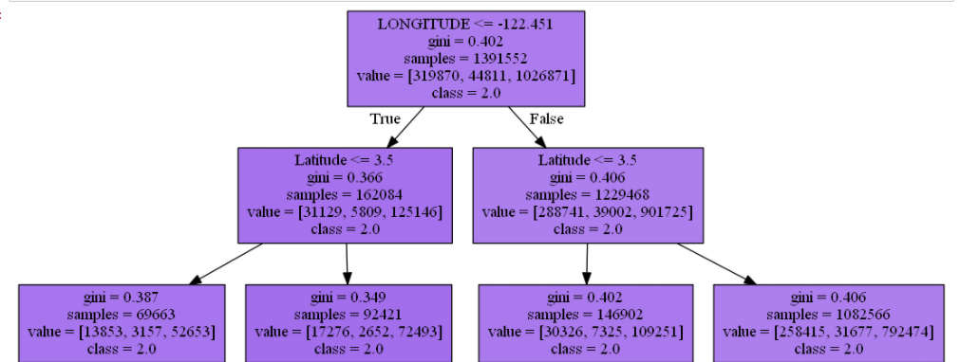
Gini: The “diversity” of the population in
this node. The tree is built to
minimize diversity in its leaves
Samples: How many objects of the
training set fall into this node
Value: How many belong to class 0 and
How many to class 1 & 2

